Slide 1
Classification
Classification: Basic Concepts
  Bayes Classification Methods

Slide 2
What are Bayesian classifiers?
Bayesian classifiers are statistical classifiers.
They can predict class membership probabilities such as the probability that a given tuple belongs to a particular class.
The crux of the classifier is based on the Bayes theorem.
Studies comparing classification algorithms have found a simple Bayesian classifier known as the naive Bayesian classifier to be comparable in performance with decision tree and selected neural network classifiers.
Bayesian classifiers have also exhibited high accuracy and speed when applied to large databases.

Slide 3
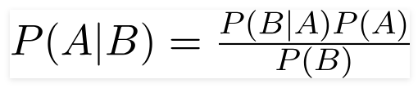
Bayes Theorem
Using Bayes theorem,
  we can find the probability of A happening, given that B has occurred.
Here,
  B is the evidence
  A is the hypothesis.

Slide 4
Bayes Theorem
Here,
  B is the evidence – data sample
  A is the hypothesis. - A belongs to class C
Classification is to determine P(A|B), (i.e., posteriori probability): the probability that the hypothesis holds given the observed data sample B
P(A) (prior probability): the initial probability
  E.g., B will buy computer, regardless of age, income, …

Slide 5
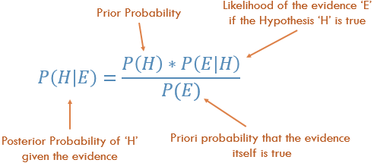
https://deepai.org/machine-learning-glossary-and-terms/posterior-probability

Slide 6
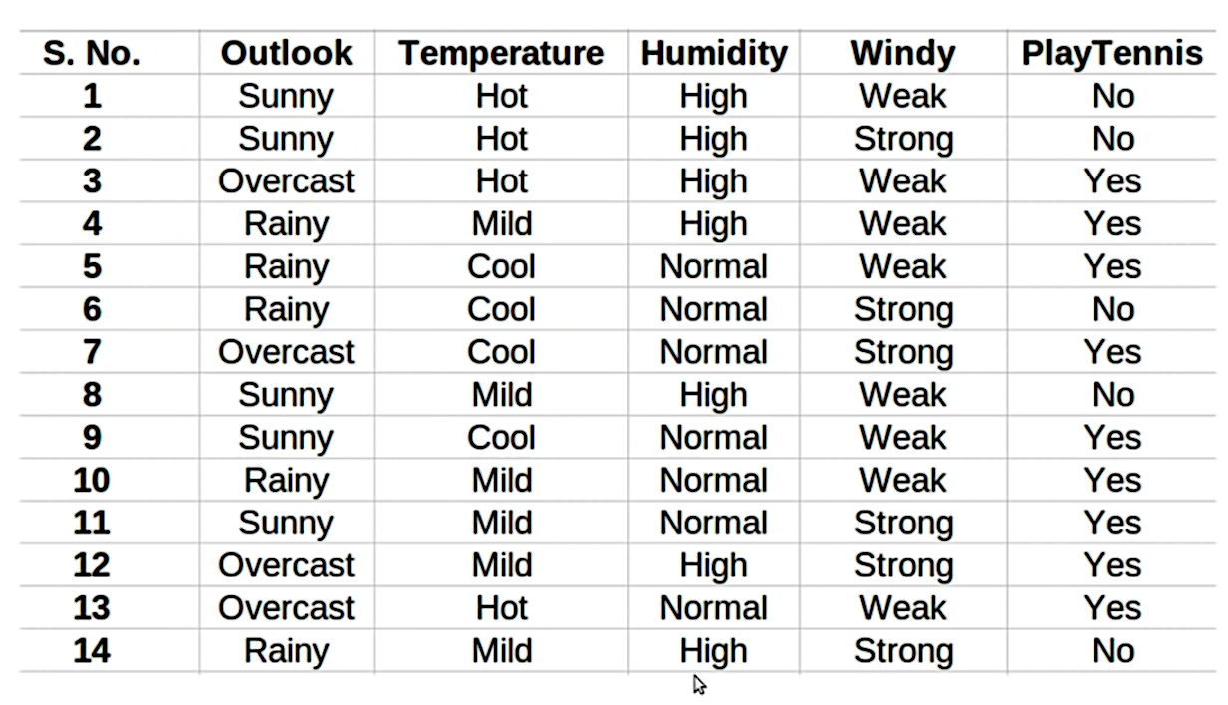
Naïve Baye’s Classifier

Slide 7
Naïve Baye’s Classifier
Assume that no pair of features are dependent.
  For example, the temperature being ‘Hot’ has nothing to do with the humidity or the outlook being ‘Rainy’ has no effect on the winds.
  Hence, the features are assumed to be independent.
Secondly, each feature is given the same weight(or importance).
  For example, knowing only temperature and humidity alone can’t predict the outcome accurately.
  None of the attributes is irrelevant and assumed to be contributing equally to the outcome.

Slide 8
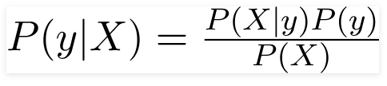

Naïve Baye’s Classifier
According to this example, Bayes theorem can be rewritten as:
The variable y is the class variable(play tennis), which represents if it is suitable to play tennis or not given the conditions.
Variable X represent the parameters/features.
X is given as,

Slide 9
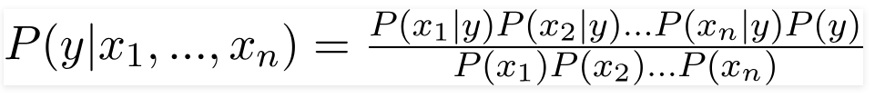
Naïve Baye’s Classifier
Here x_1,x_2….x_n represent the features, i.e they can be mapped to outlook, temperature, humidity and windy.
By substituting for X we get,
Now, you can obtain the values for each by looking at the dataset and substitute them into the equation.
For all entries in the dataset, the denominator does not change, it remain static.
Therefore, the denominator can be removed and a proportionality can be introduced.

Slide 10


Naïve Baye’s Classifier
In our case, the class variable(y) has only two outcomes, yes or no.
There could be cases where the classification could be multivariate.
Therefore, we need to find the class y with maximum probability.
Using the above function, we can obtain the class, given the predictors.

Slide 11
Example
Class:
C1:playtennis = ‘yes’
C2:playtennis = ‘no’
Data to be classified:
X = (outlook =sunny,
Temperature = mild,
Humidity= normal,
Windy=weak)

Slide 12
Example
Prior Probability
P(C_{i}): P(playtennis = “yes”) = 9/14 = 0.643
P(playtennis = “no”) = 5/14= 0.357

Slide 13
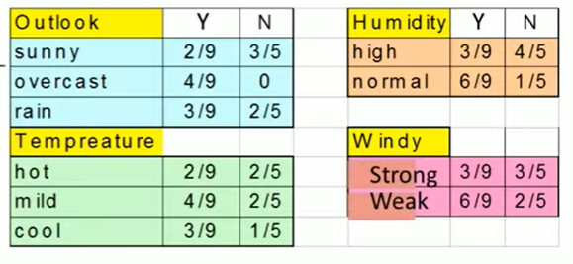
Example
Conditional Probability

Slide 14
Example
Compute P(X|C_{i}) for each class
P(outlook =“sunny” | playtennis = “yes”) = 2/9 = 0.222
P(outlook =“sunny” | playtennis = “no”) = 3/5 = 0.6
P(Temperature = “mild” | playtennis = “yes”) = 4/9 =0.444
P(Temperature = “mild” | playtennis = “no”) = 2/5 = 0.4
P(Humidity= “normal” | playtennis = “yes) = 6/9 = 0.667
P(Humidity= “normal” | playtennis = “no”) = 1/5 = 0.2
P(Windy=“weak” | playtennis = “yes”) = 6/9 =0.667
P(Windy=“weak ” | playtennis = “no”) = 2/5 = 0.4
Class:
C1:playtennis = ‘yes’
C2:playtennis = ‘no’
Data to be classified:
X = (outlook =sunny,
Temperature = mild,
Humidity= normal,
Windy=weak)

Slide 15
Example
P(X|C_{i}) : P(X|playtennis = “yes”) = 0.222 x 0.444 x 0.667 x 0.667 = 0.044
P(X|playtennis = “no”) = 0.6 x 0.4 x 0.2 x 0.4 = 0.019
To find the class, Ci , that maximizes P(X|Ci)P(Ci), we compute
P(X|playtennis = “yes”) P(playtennis = “yes”) = 0.044 * 0.643 = 0.028
P(X|playtennis = “no”) P(playtennis = “no”) = 0.019 * 0.357 = 0.007
X = (outlook =sunny, Temperature = mild,Humidity= normal,Windy=weak) = YES

Slide 16
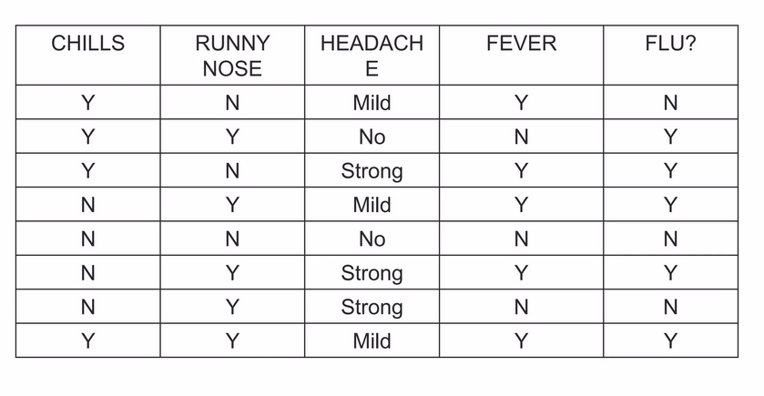

Practice Problem 1

Slide 17
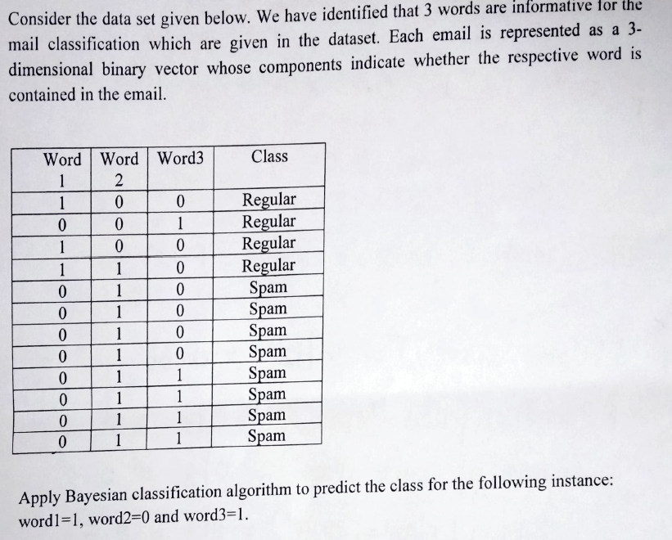
Practice Problem 2

Slide 18



